Slide 1

IMPLEMENTATION OF RING COUNTER AND JOHNSON COUNTER WITH CONTROL LOGIC
END SEMESTER ASSESSMENT (ESA)
B.TECH. (CSE) III SEMESTER
DIGITAL DESIGN & COMPUTER ORGANIZATION LABORATORY
UE18CS206
Project Number : 7
Project Batch Number : E4
Student 1:- Name – Pavan N. SRN – PES2UG19CS277
Student 2:- Name – Pavitra K. SRN – PES2UG19CS279
Student 3:- Name – Pawan Prasad P. SRN – PES2UG19CS280
Student 4 :- Name – Phani Kumar Vedurumudi SRN – PES2UG19CS281

Slide 2
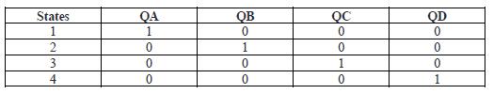
RING COUNTER
A ring counter is also known as SISO (serial in serial out) shift register counter where the output of the flip flop is connected to the input of the flip flop. The designing of four bit ring counter can be done by using four D-Flip Flops with a common clock signal and overriding input can be connected to pre-set and clear. The main function of pre-set and clear is to change the output value when the input clock signal changes. Based on these signals they operate in ring format hence it is called a ring counter. The number of states is the number of flip flops used. The output of last flip-flop is connected to the input of the first flip-flop in case of ring counter.

Slide 3
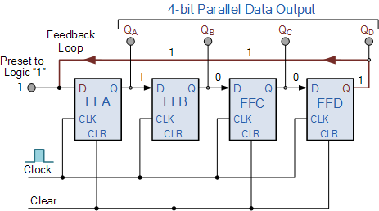
CIRCUIT DIAGRAM

Slide 4
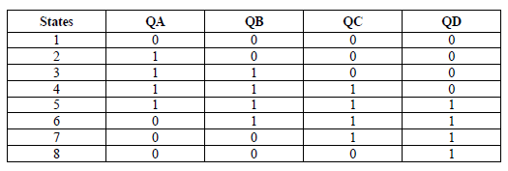
JOHNSON COUNTER
The Johnson Ring Counter, also called the Twisted Ring Counter is a shift register with feedback exactly the same as the standard Ring Counter, except that the inverted output of the last flip-flop is connected back to the input of the first flip-flop. Unlike the standard ring counter, it only needs half the number of flip-flops and its modulo number is halved. Johnson Ring Counter is nothing but Johnson Counter. The output of each flip-flop is connected with the input of the succeeding flip-flop. The complemented output of the last flip-flop is connected with the input of the first flip-flop in case of Johnson Counter.

Slide 5
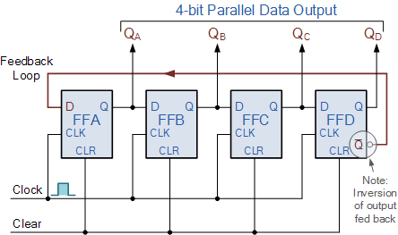
CIRCUIT DIAGRAM

Slide 6
VERILOG CODE USED (TEST BENCH NOT REQUIRED)
Ring Counter –
module ring_counter (input clk, clr, output [3:0] out);
reg[3:0] cnt;
always @(posedge clk)
if (clr)
cnt <= cnt<<1;
cnt = 4'b0001;
else
begin
cnt <= cnt<<= cnt[3];
end
assign out=cnt;
endmodule

Slide 7
VERILOG CODE USED (TEST BENCH NOT REQUIRED)
Johnson Counter –
module johnson_counter(clk, clr, out);
input clk,clr;
output [3:0] out;
reg [3:0] df;

Slide 8
always @(posedge clk)
begin
if(clr)
dff=4'b0000;
else
begin
dff[3]<=dff[2];
dff[2]<=dff[1];
dff[1]<=dff[0];
dff[0]<=(~dff[3]);
end
end
assign out = dff;
endmodule

Slide 9
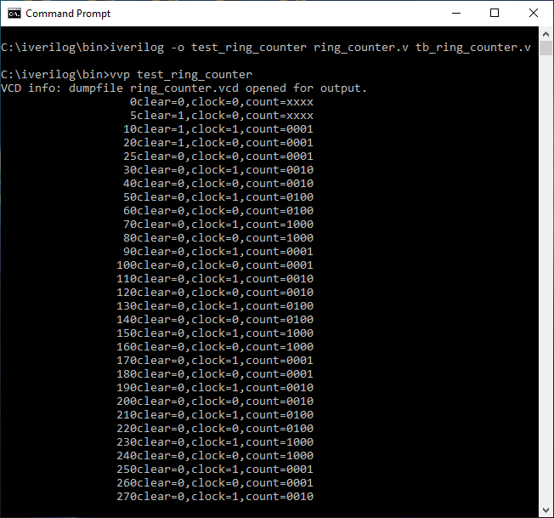
SCREENSHOTS
Ring Counter –
Command Prompt :

Slide 10
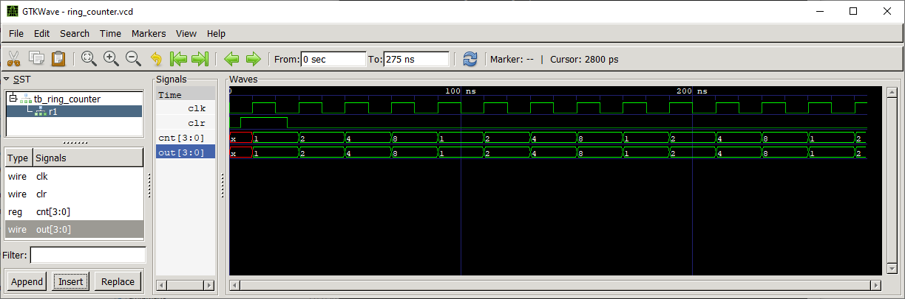
Waveform:

Slide 11
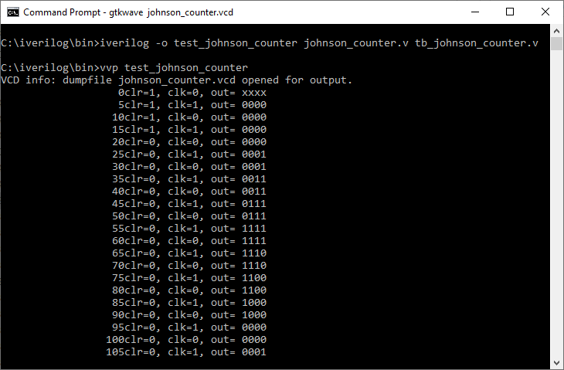
SCREENSHOTS
Johnson Counter –
Command Prompt :

Slide 12
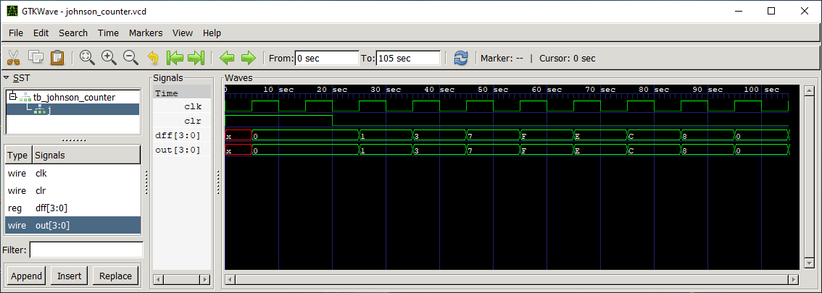
Waveform:

